Slide 1
GAMIFYING PROGRAMMING LEARNING AND PROBLEM SOLVING
Majd Kittaneh & Omar SHAIKH IBRAHIM

Slide 2
Abstract
This project presents the concept of fusing game design with programming teaching, aiming to leverage the principles of game design to create an engaging and effective environment for individuals to learn programming concepts.

Slide 3
Introduction
We want to use Interactive Media to teach Programming.
Video Games is one of the best forms of Interactive Media.
Video Games’ core is Problem Solving:
How can I solve this puzzle?
How can I reach that place?
How fast can I reach it?
How to improve my skills?
Programming’s core is Problem Solving:
How can I describe the problem as a code?
How can I make my code faster?
“The goal is to teach Programming using Video Games”

Slide 4
Problem Statement
Many programming courses focus heavily on theoretical concepts, which
gives learners no opportunities to apply their knowledge to real-world
problems.
=> Creating a video game environment with its own rules and objectives simulates the situation of writing a code to solve a real problem.
Traditional education follows a one-size-fits-all approach, which makes a
problem for individuals with different learning styles while the newer generations being
digital content consumers.
=> This weakens the classroom traditional setting and calls for a more interactive methods.

Slide 5
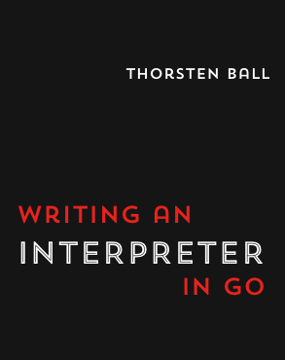
How?
We developed our own interpreter-based programming language with simple syntax following the “Writing an Interpreter In Go” book.
This language will be used by the player to solve various puzzles in a video game environment.
Starting with introductive simple puzzles, the player will learn the basics of Programming and then puzzles’ difficulty will increase with their skills and knowledge.

Slide 6
What is an Interpreter?
An interpreter is a computer program that directly executes instructions written in a programming or scripting language, without requiring them previously to have been compiled into a machine language program.

Slide 7
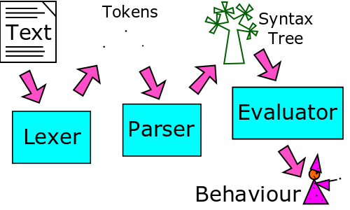
The three main stages of an interpreter
Lexer: Code to Tokens.
Parser: Tokens to Syntax Tree.
Evaluator: Syntax Tree To Actions.

Slide 8
Why not an established language?
Making our own interpreter will give us the flexibility we need in creating interactive environments.
Since we have the access to the 3 components of the interpreter: Lexer , Parser and Evaluator, we will be able to control all steps of code execution.
This will help us do things we can’t if we used an established language like:
Check if the code contains specific statements.
Dealing with different statements in different ways.
Making delays at specific parts of code for the player to see their effect in-game.
Managing variables stored in memory without changing code written by player.

Slide 9
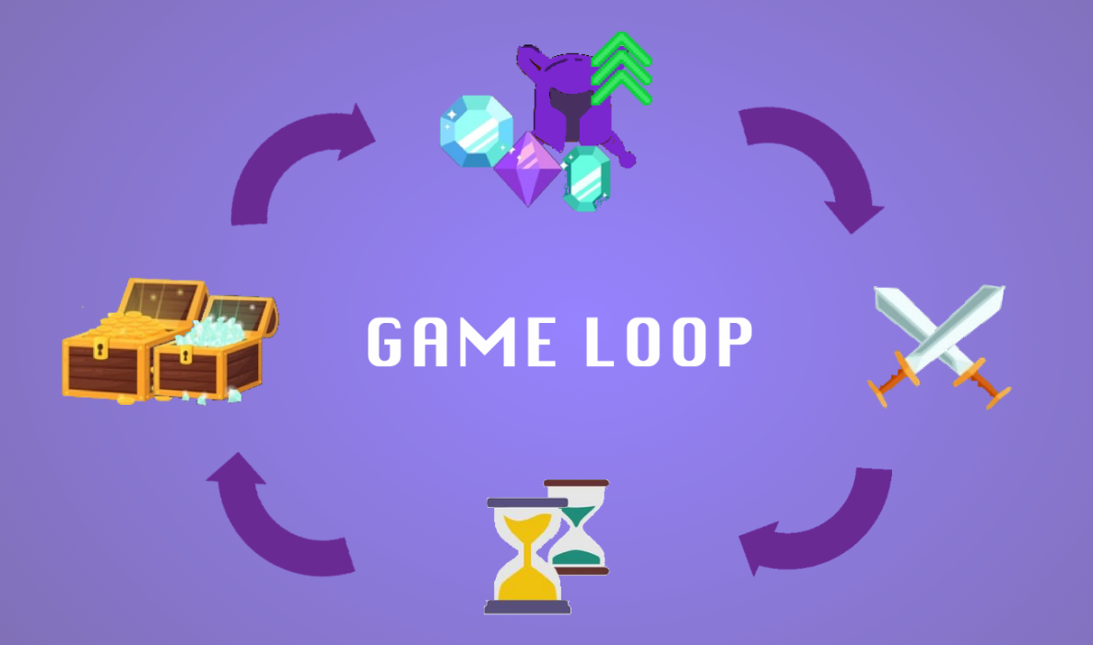
What is a core loop?
In every games, core loop are the main activities that dictate the game experience and players’ journey to constantly keep them engaged, which serve as the fundamentals of the whole game.

Slide 10
Our game core loop
Gathering information.
Writing the code.
Testing the code.
Repeat.

Slide 11
Core Loop – Gathering information
The player is introduced to a new level.
The player can swap between textual description and the player-view/visual description at any time.
Levels will have randomly generated variables.

Slide 12
Core Loop – Writing Code
Taking information from the level and from the description, the player will be ready to write his code.

Slide 13
Core Loop – Testing the code
Now, the player-written code will be tested by the game. This will be done differently for each level.
After all test cases are done, the results will be compared with the right ones and give the result to the player.

Slide 14
Core Loop - Repeat
Solving the puzzle and writing the right code gives the player access to a new level with new challenge.
Failing in doing so, gives him the choice to retry and face the same challenge again.

Slide 15
Level Showcase – Introducing Conditions
In the following slides, we will show a level from the game and break it down to the core loop and get into the details of game’s workflow.
This level is the second one in the game and it introduces the player to the conditions concept.

Slide 16
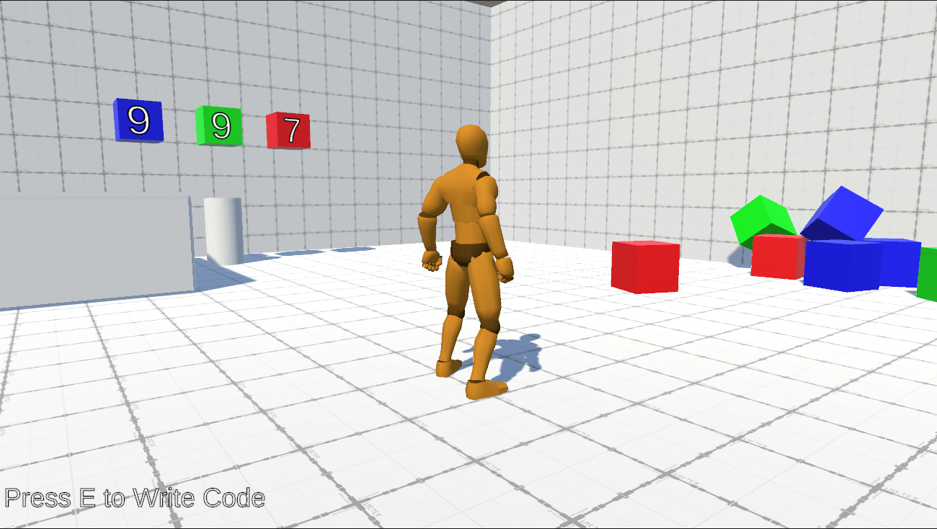
Level Showcase – Player-View
Machine
The Player
Big Cubes
The level starts and the player sees cubes at his right and other numbered ones in front of him.
On-screen instructions tells the player to press 'E' key to write his code.
This is the visual description part of the level.
Problem Visual/Interactive Description

Slide 17
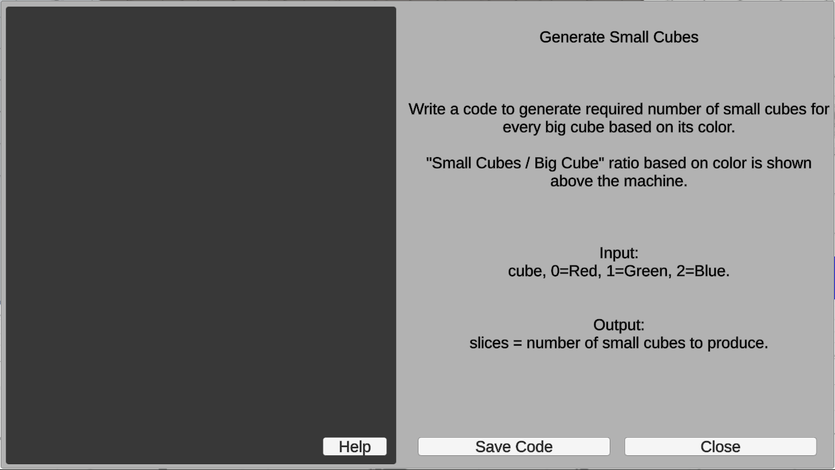
Level Showcase – Text Description
By pressing 'E' key, this UI shows where the player can read the textual description of the problem.
Player will use it along with the visual description in the player-view to write the code which solves the problem.
Save Code for execution
Access Guide
Problem Textual Description
Return to Player-View

Slide 18
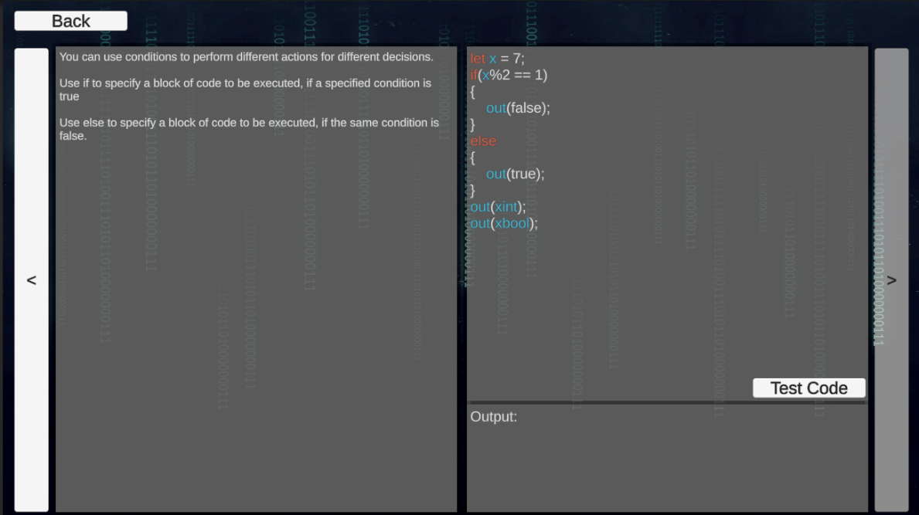
Level Showcase – Guide
This is the “Guide” screen, player can access it by pressing “Help” button from previous screen.
Each tutorial has its example code and explanation.
Pressing “Test Code” will print the output of the code in the output section.
Previous Tutorial
Next Tutorial

Slide 19
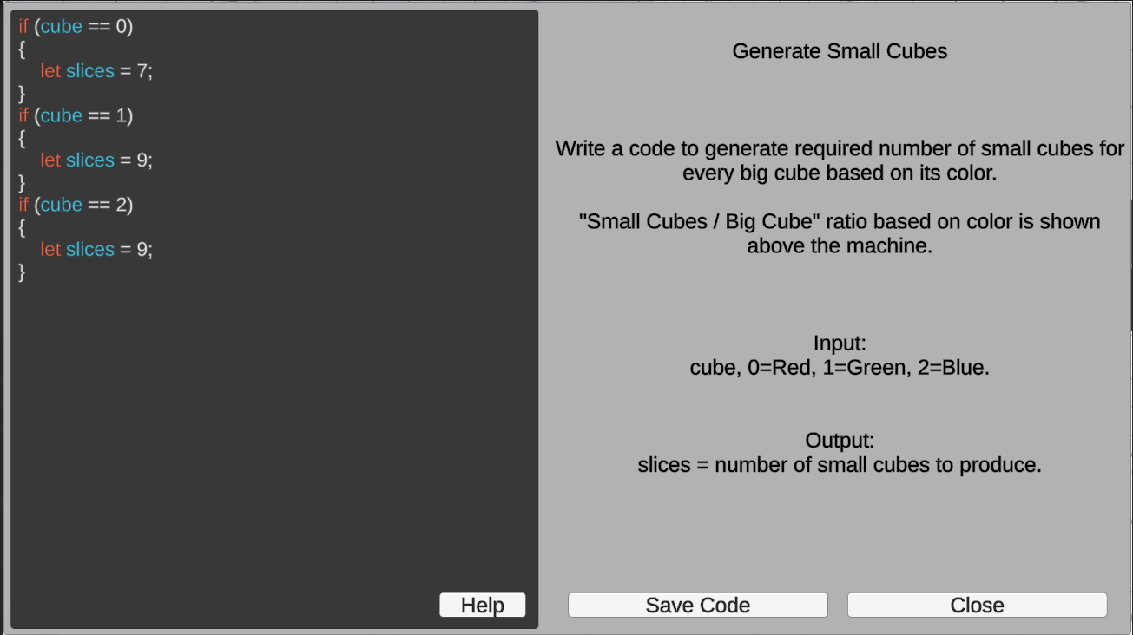
Level Showcase – Writing Code
Here, the player wrote the code and will press the save button to execute the code when it is used.

Slide 20
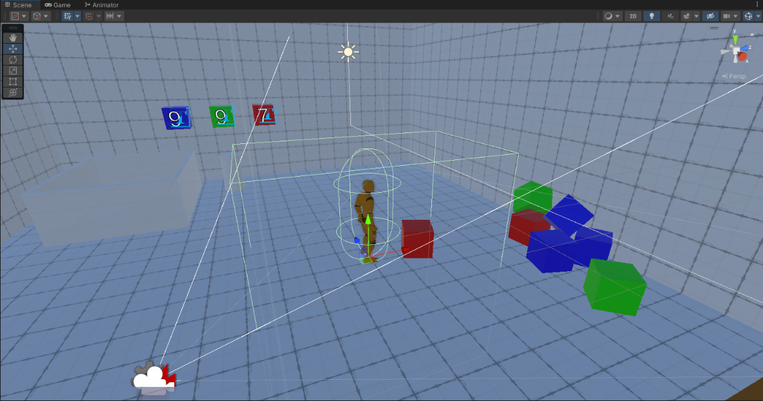
Level Showcase – Collisions
This image is from the developer view in the editor where the colliders are visible.
These colliders are child objects of the player so they move with the character.
The “Pick Trigger” controls objects to be picked up by player. An object inside the trigger area will be picked if it satisfies developer’s rules.
The “Player Collider” handles player body’s physical collisions with other objects.
Box Collider – Pick Trigger
Capsule Collider – Player Collider

Slide 21
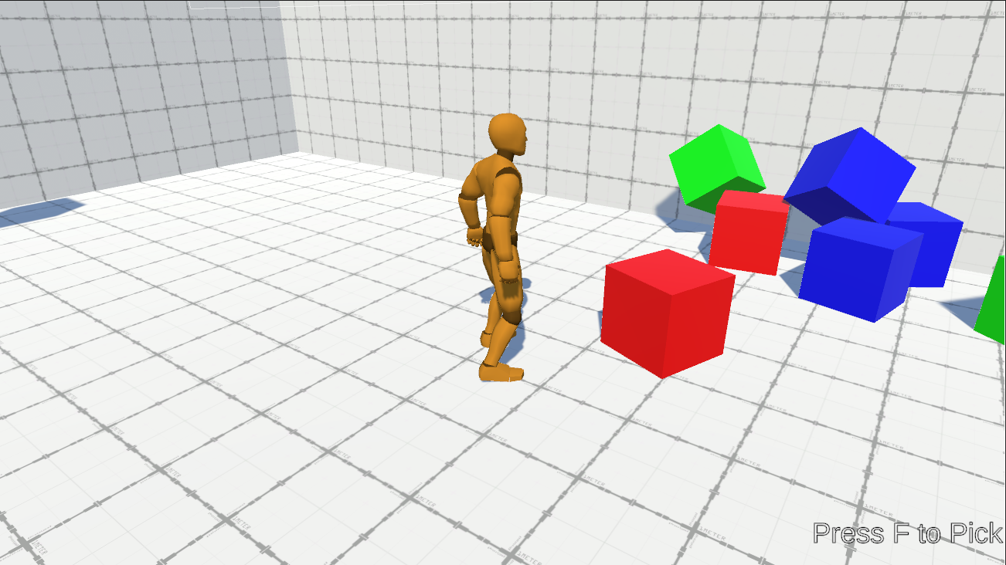
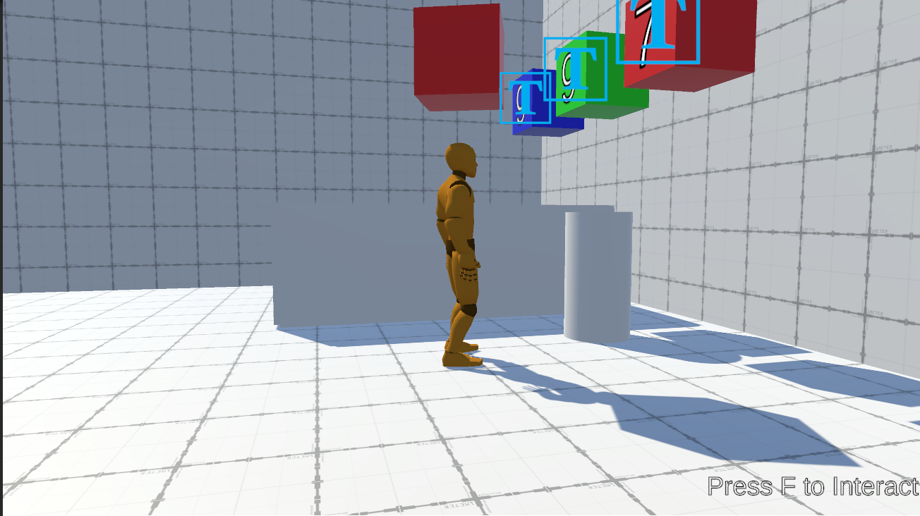
Level Showcase – Picking
Context Sensitive Input: Same input key ‘F’ will result in different actions “Pick/Interact” depending on the context the player is in.

Slide 22
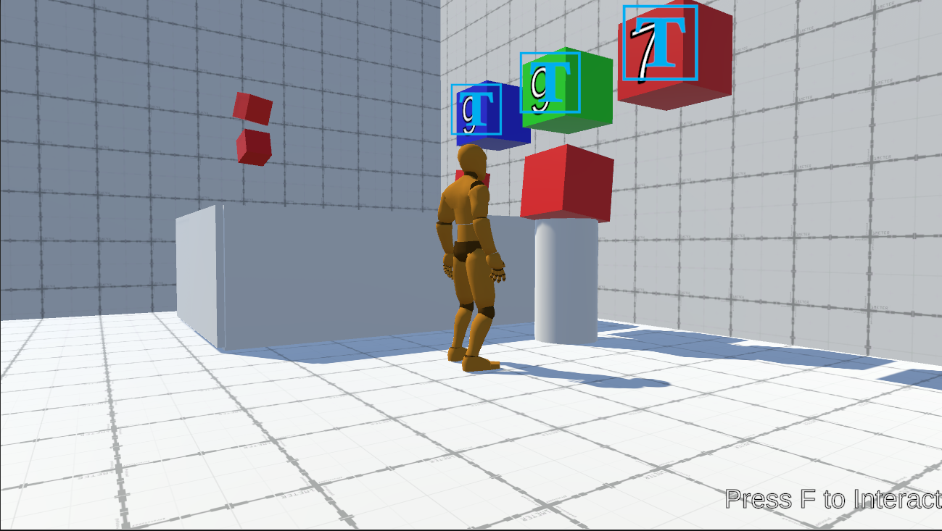
Level Showcase – Executing Code
Interacting with the “Machine” object, the cube is fixed in its place which means the code is executing.
The code will start executing for each cube attached.
Generating small cubes depending on the output of the player-written code.
Finally, results will be checked and depending on the results, the player will continue to the next level or restart same level.

Slide 23
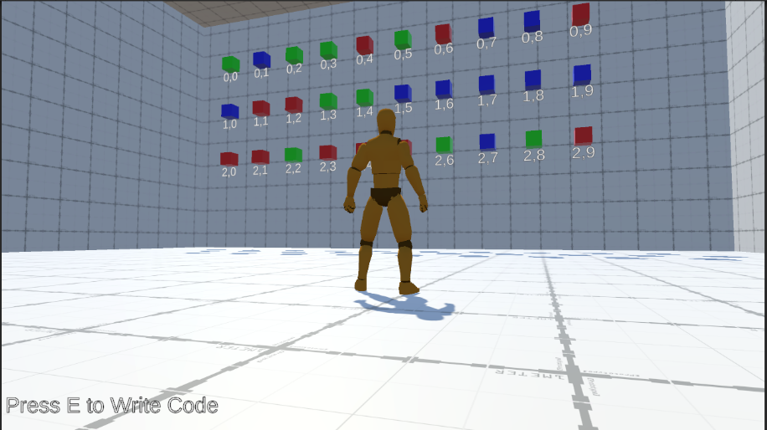
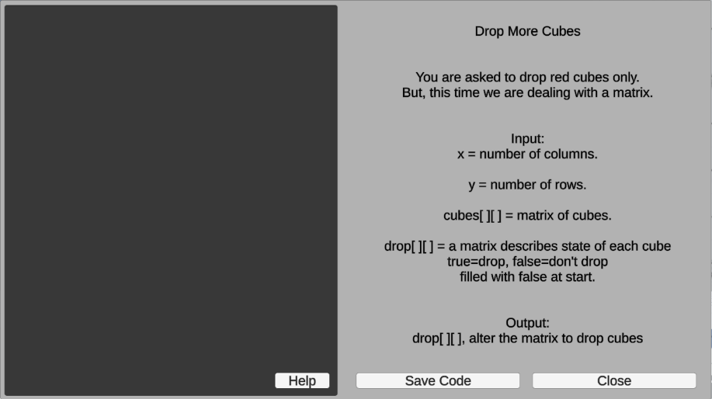
Level Showcase – Introducing Matrices
This is another level where player learns about matrices.
The objective is to drop red cubes by setting the value corresponding to its index to “true” instead of “false”.
An object can be dropped by adding the rigidbody component to it which applies physics and gravity to it.
The rigidbody component will be added in real-time for every “true” value.

Slide 24
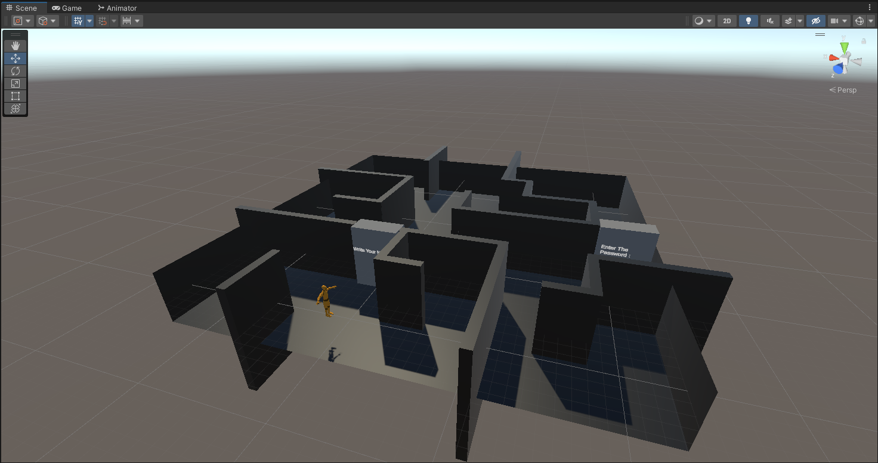
Progression
Player will continue solving puzzles with increasing difficulty and knowledge until the last level.
The last level is considered the most difficult as it contains two puzzles to solve in a maze.
The two puzzles revolve around cryptography concepts.

Slide 25
Challenges
Difference between source (the book) language (Go) and the target (Unity) language (C#).
Creating interactive puzzles that represents a programming concept is not easy and needed some iteration.
We are new to the game design field and its principles.
Thinking about code being executed in every frame where 200+ frames generated per second.
Dealing with Unity’s limitations with multithreading and synchronization.

